Slide 1

EXPANSION
Does timing matter? Are we too late to expand? If we do expand, does size of an outlet matter?

Slide 2
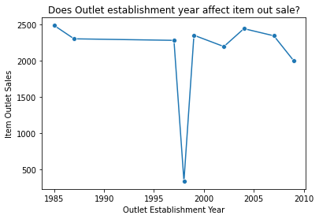
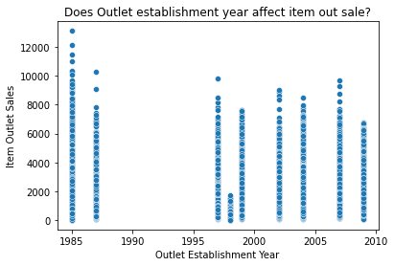
There is no timing the market. This line plot and scatter plot show outliers in 1985 and 1998. It does currently seem like a downtrend, but we did see an uptick after 1998. I do not see a strong correlation between establishment year and item sales

Slide 3
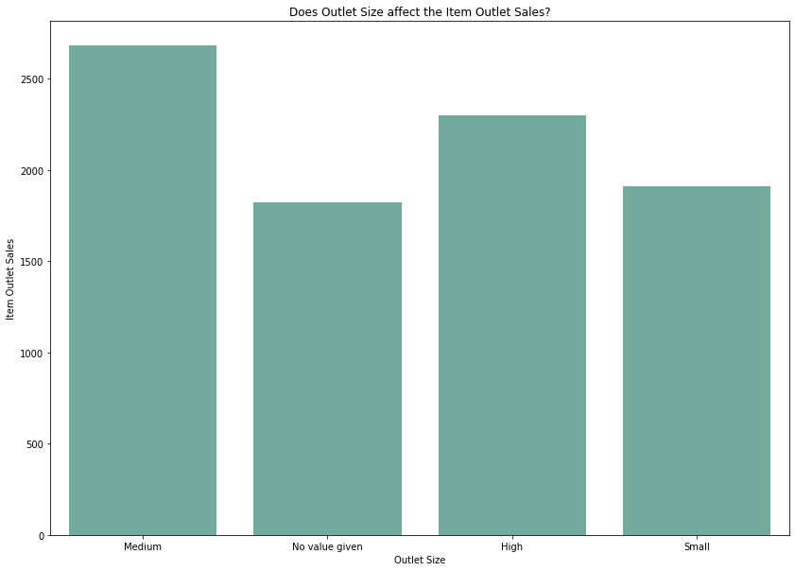
From the bar graph,
We can see that medium sized outlets perform better for item sales compared to smaller sized and bigger sized outlets

Slide 4

What did we learn?
There is no trend or strong correlation between the time of establishment and the item sales of an outlet. It seems like other circumstances can explain the outliers of the line plot. There is no magic year that boosts sales.
We also learned that medium sized outlets perform better than smaller ones and bigger ones. This can be an important insight when considering expansion.Saving costs from buying bigger sized outlets and also understanding that saving too much can hurt item sales if you aim to small for sizing. It is important to find the right balance.

Slide 5

Does timing matter? Are we too late to expand? If we do expand, does size of an outlet matter?
PLAN OF ACTION
We can not time the market of when it is best to establish an outlet. We should look at other factors affecting the marketplace.
We should invest resources in finding the perfect balance of cost to purchase an outlet and the outlet size. We should avoid bigger sized outlets to avoid costs.
If you have the resources and the costs make sense, you should expand into medium sized outlets

